Slide 1

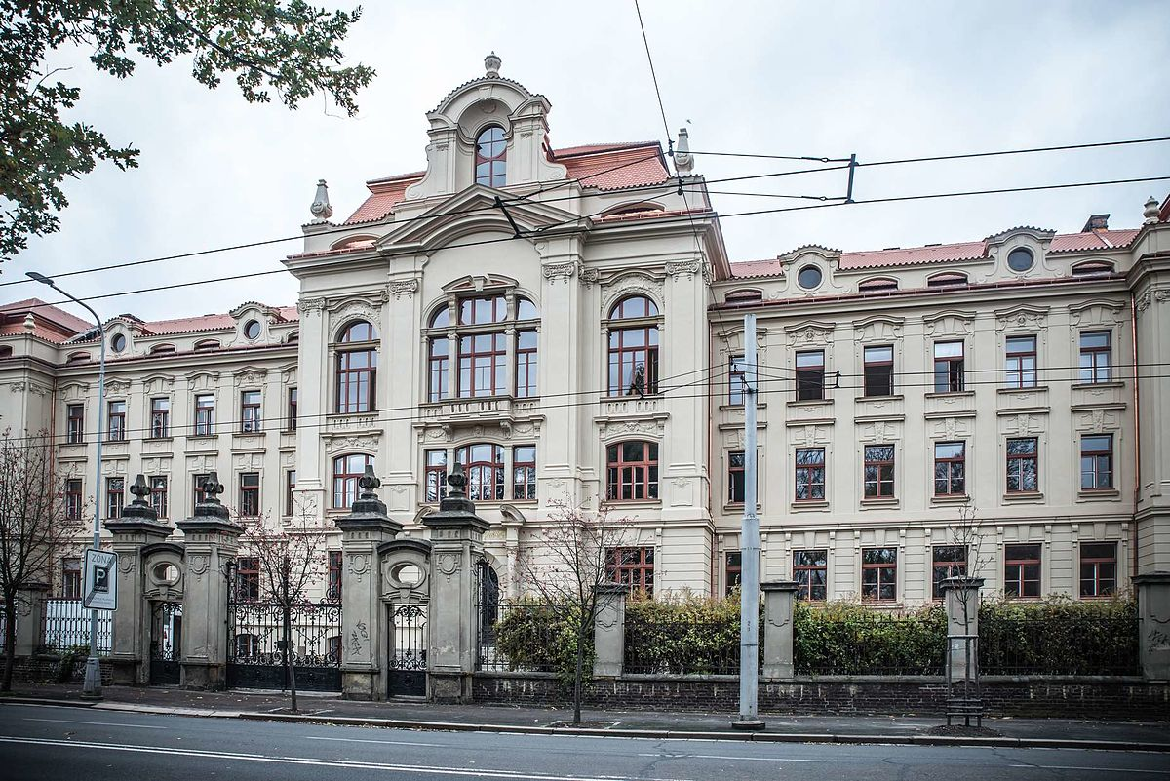
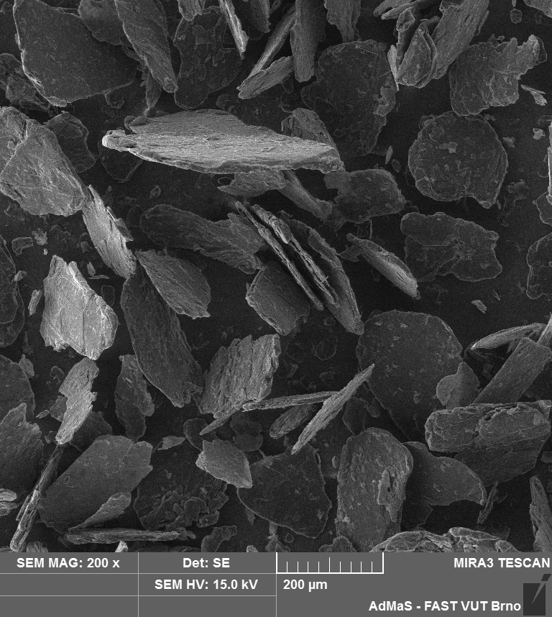







POSTER TITLE POSTER RECOMMENDED FORMATTING AND VISUALS (ARIAL, BOLD 44)
LOGO of your institution 3.5 X 3.5
First name Last name ¹, First name Last name ², First name Last name ², ... (Arial, last name in bold size 36)
¹ Brno University of Technology, Faculty of Civil Engineering,
Department of Technology of Building Materials and Components (Arial, 24)
² Institutions of other co-authors (Arial, 24)
INTRODUCTION
Text text text text text text text text text text text text text text text text text text text text text text text text text text text text text text text text text text text text text text text text text text text text text text text text text text text text text text text text text text text text text text text text text text text text text text text text text text text text text text text text text text text text text text text text text text text text text text text text text text text text text text text text text text text text text text text text text text text text text text text text text text text text text text text text text text text text text text text text text text text text text text text text text text text text text text text text text text text text text text text text text text text text text text text text text text text text text.
This template serves as a template for the creation of a poster for the 26rd JUNIORSTAV 2024 international scientific conference on civil engineering. This template is non-binding! the only thing you need to observe is the size of the poster. All text should have been written in Arial font, size 24 for good readability.
The purpose of the poster is to encourage informal discussion during coffee breaks. It is a graphic representation of your paper and the topic presented. The poster presentation is itself a summary of your research and usually includes an overview of the research objectives, experimental methods, materials, results and discussion. The goal of the poster is to effectively and clearly communicate the results of your research in as few words as possible. However, keep the poster format set at 60 x 90 cm.
The poster should be attractive to others in its content and layout. You can freely move the fields and change their width to suit your needs. In addition to but the paper format, also keep the outer edges of the page is 2 cm. Text preferably aligned in a block.
DISCUSSION
Text (type Arial, size 24). The same rules apply for describing tables and graphs (or referring to them in the text) as for writing articles.
Tab. 1 Example of table and label layout, Arial, italic size 20
As mentioned, the goal of the poster is to engage the reader. Therefore, modify the layout of the table according to your needs. However, make sure that the text in the tables and graphs is legible. Also choose an appropriate size for the images.
The recommended resolution is at least 150 to 300 dpi. Insert images in .jpg or .png format. If they are not your own photos, be sure to attribute the source or author.
Fig. 2 Example of image or graph placement, A) our faculty, B) electron microscope image, magnification 20 000x
METHODS AND MATERIALS
Mark | Sample | p1 | Max power [mm] | p2 | Strength [N] | Stretch [mm]
F3 | 1,143a | 0,285^{b} | 0,286 | 0,593 | 0,286 | 0,593
Fz | 1,143 | 0,285 | 0,067 | 0,796 | 0,067 | 0,796
C4 | 2,571 | 0,109 | 0,600 | 0,439 | 1,667 | 0,197
The main purpose is to ensure that the person viewing your poster understands the goal and subject of your research, even if they are not in the same field as you.
Other rules:
Each paragraph should be no more than 2 sentences and less than 5 sentences.
Each sentence should contain no more than 30 words.
Use bullet points whenever possible.
Use numbers to structure your content and to show your key findings.
Focus on the key questions you want to answer. Start by answering the "Why?" question you are working on, followed by "What am I adding?", "How? Methods," What did I find? and „What do I recommend?“
Clear areas between paragraphs and chapters are valuable. A direct message presented using a clear structure is easier to read and will attract your audience.
A)
B)
RESULTS
CONCLUSION
Present the results preferably in graphical form using graphs embedded as images and commenting on them. All figures, graphs, tables should be mentioned in the text.
Graphs and figures should be easy to read, labels should be centered, and text in graphs should be in ENG.
Fig. 1 Example of graph location Grain size of graphites
Text text text text text text text text text text text text text text text text text text text text text text text text text text text text text text text text text text text text text text text text text text text text text.
Finish with a short conclusion. Summarize your results and any findings. Also list the main points of your research.
Be concise
Be direct
You can structure the text in bullet points. Or express the main highlights of the paper graphically, for example, as follows:
We managed to explain the formatting.
Billboards will be ready for posting, we will help you with posting.
If you have any questions, please contact us.
Changing the formatting is not appropriate.
We haven't forgotten anything
ACKNOWLEDGMENTS
This paper was funded with support from project 487-78JVB
First Last name
Your institution
youremail@email.com
Country

